Slide 1


Pointers in C
&
String Processing
23rd April,2015
Soumyadeep Roy
2nd year,CSE
Kalyani Government Engineering College

Slide 2
strtok() Definition
Firstly, you need to link the header file ‘string.h’ at the top of the program
#include<string.h>
Declaration:
char *strtok(char *str, const char *delim)
delim - This is the C string containing the delimiters.
Return Value
This function returns a pointer to the last token found in the string. A null pointer is returned if there are no tokens left to retrieve.

Slide 3
String Problem 1
Problem: First line has space-seperated strings. You have to print them in ascending order. Maximum number of strings is 100, and maximum possible length is 99.
(Note: You do not have think about sorting)

Slide 4
Sample Input:
Kolkata Delhi Mumbai Bangalore Chandigarh
Sample Output:
Bangalore Chandigarh Delhi Kolkata Mumbai

Slide 5
Using strtok Level 1
char state[10000];
char store[100][100];
char *first;
int counter=0;
scanf(" %[^\n]s",state) ;
first = strtok(state, s); //Stores the starting address
strcpy(store[counter++],first); //Equality does not work
first = strtok(NULL, s);
while(first!=NULL){
strcpy(store[counter++],first);
first = strtok(NULL, s);
}

Slide 6
String Problem 2
Problem: First line has space seperated strings. You have to print them in ascending order. Maximum number of strings is 100, and maximum possible length is 99.
Followed by maximum ‘n’ number of lines of space seperated strings, where n = 10.
(Note: You do not have think about sorting)

Slide 7
Sample Input:
Kolkata Delhi Mumbai Bangalore Chandigarh
Yellow Red Green Purple Indigo Magenta
Sample Output:
Bangalore Chandigarh Delhi Green Indigo Kolkata Magenta Mumbai Purple Red Yellow

Slide 8
Using strtok Level 2
char state[10000];
char store[100][100];
char *first;
int counter=0;
while(scanf(" %[^\n]s",state) !=EOF){
first = strtok(state, s); //Stores the starting address
strcpy(store[counter++],first); //Equality does not work
first = strtok(NULL, s);
while(first!=NULL){
strcpy(store[counter++],first);
first = strtok(NULL, s);
}
}

Slide 9

atoi() Definition
Firstly, you need to link the header file ‘stdlib.h’ at the top of the program
#include<stdlib.h>
Declaration:
int atoi(const char *str)
str - The string representation of an integral number.
Return Value
This function returns the converted integral number as an int value. If no valid conversion could be performed, it returns zero.

Slide 10
String Problem 1a:
Replace strings with integers.
Follow same method as before with slight modification.
scanf(" %[^\n]s",state) ;
first = strtok(state, s); //Stores the starting address
store[counter++]=atoi(first);
// strcpy(store[counter++],first);
first = strtok(NULL, s);
while(first!=NULL){
store[counter++]=atoi(first);
first = strtok(NULL, s);
}

Slide 11
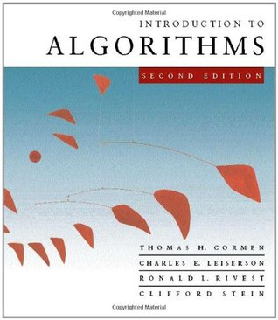

Slide 12

Sorting
Bubble Sort
Selection Sort
Insertion Sort
Merge Sort
Heap Sort
Quick Sort
Shell Sort
Counting Sort
Radix Sort ...
Order of SORTING:
Ascending
Non-decreasing
Descending
Non-increasing

